Slide 1
Introduction to TOC
Prof. Nisha V M

Slide 2
What is computation?

Slide 3
Computation
A computation is any type of calculation that includes both arithmetical and non-arithmetical steps and which follows a well-defined model.

Slide 4
Models of computation
a model of computation is a model which describes how an output of a mathematical function is computed for an input
What are the various models of computation?

Slide 5
Models of computation
Mathematical equations
Logic circuits
Automata models

Slide 6
Automata -model of computation
Which are the possible elements in a computation?
How to represent each element ?

Slide 7
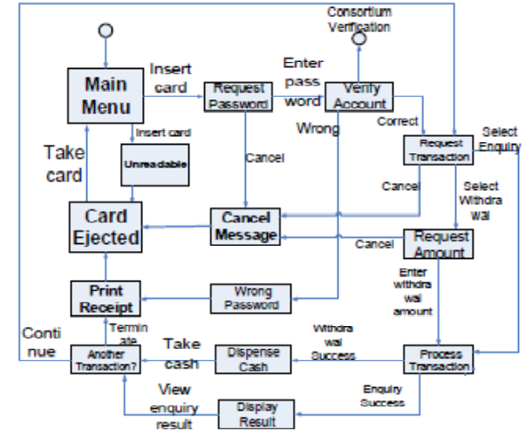
Sample state diagram for an ATM

Slide 8
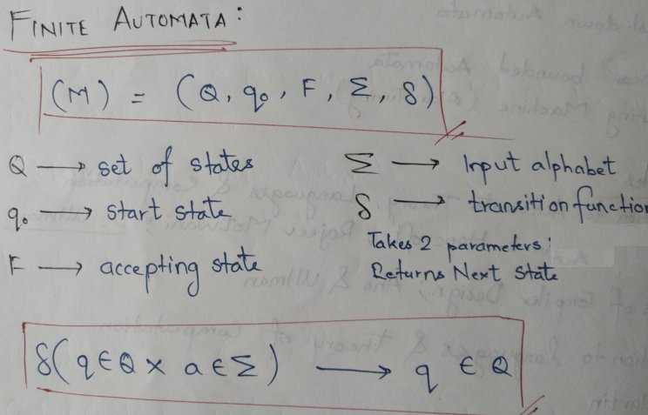
Definition of Finite automata

Slide 9
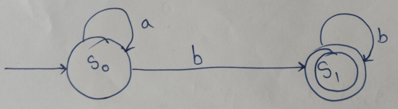
Automata- strings end with b
Input = {a, b}

Slide 10
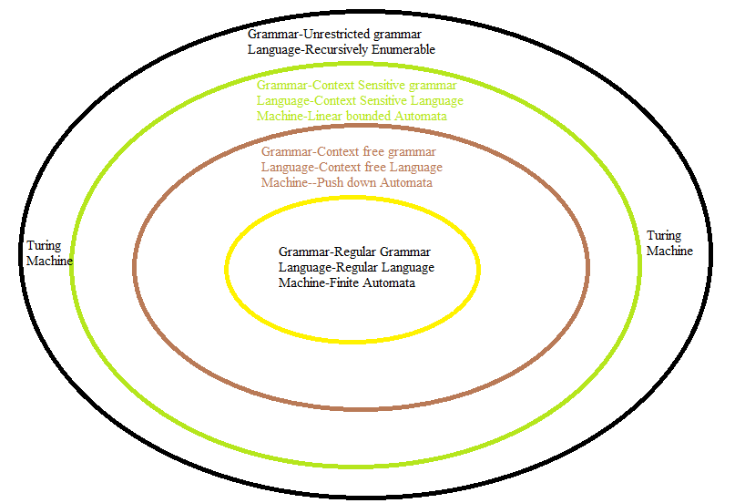
Chomsky Hierarchy

